Slide 1
Post Covid-19 syndrome And Covid Vaccine
A thorough analysis
Dr. Arvind Palawat
Principal specialist Medicine
SMS Medical College Jaipur

Slide 2
What is Post Covid-19 syndrome?
The presentation and management of COVID-19 can be described in to 3 main phases;
Acute COVID-19: signs and symptoms of COVID-19 for up to 4 weeks.
Ongoing symptomatic COVID-19: signs and symptoms of COVID-19 from 4 to 12 weeks.
Post-COVID-19 syndrome: signs and symptoms that develop during or after an infection consistent with COVID-19, continue for more than 12 weeks and are not explained by an alternative diagnosis .

Slide 3
Long COVID-19 as defined
Long COVID- has been commonly used to describe signs and symptoms that continue or develop after acute COVID-19. It includes both ongoing symptomatic COVID-19 (from 4 to 12 weeks) and post-COVID-19 syndrome
( 12 weeks and more ).
‘’Signs and symptoms that develop during or following an infection consistent with COVID 19, which continue for more than 12 weeks and are not explained by an alternative diagnosis’’
It usually presents with clusters of symptoms, often overlapping, which can fluctuate and change over time and can affect any system of the body.

Slide 4
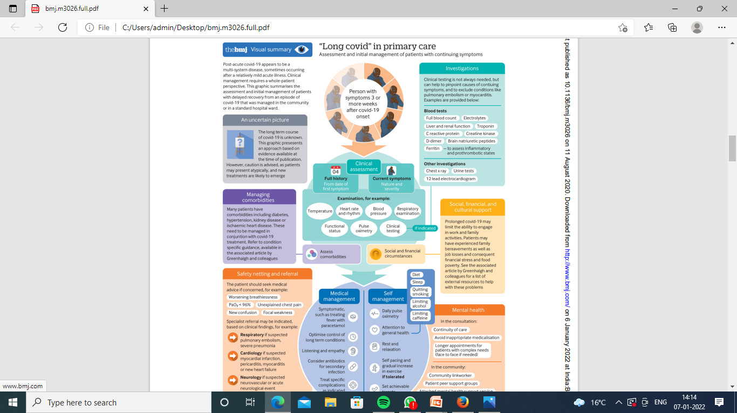

Slide 5
Fatigue | General and post-exertional fatigue (93%)
Respiratory symptoms | persistent SOB (81%), persistent cough(63%)
Musculoskeletal | including pain & muscle fatigue (72%)
Neurological | Headaches (55%), Neuro-cognitive disorder (46%), dizziness (46%)
Cardiovascular | Palpitations/ arrhythmias (42%), Postural tachycardia syndrome (25%)
Gastrointestinal | Nausea, bowel changes, indigestion (41%)
General | Persistent fever (38%), chest pain (60%), rashes (19%), ansonia (54%)
Metabolic | Worsening of diabetes or underlying metabolic disease (20%)
Psychiatric/ psychological | Sleep disorders and mood changes (76%)

Slide 6
Who gets Long Covid-19?
Some where between 2.5 - 15% of people still symptomatic for long covid-19 syndrome.
Factors that appear to be associated with a greater risk of suffering from “Long COVID-19” appear to be:
Age more then 60 years
Excess weight/ obesity
DM-2 ,COPD,CKD
Patients on immunosuppressant therapy ,organ transplant recipients
Multiple symptoms at presentation

Slide 7
Fever
May be treated symptomatically with Paracetamol or non-steroidal anti-inflammatory drugs.
Monitoring functional status in post-acute coivd-19 patients is not yet an exact science.

Slide 8
Chest Pain
Chest pain is common in post-acute covid-19 syndrome approximate incidence 12 to 44 %. The clinical priority is to separate musculoskeletal and other non-specific chest pain from serious cardiovascular conditions.
Cardiopulmonary complications include myocarditis, pericarditis, myocardial infarction, dysrhythmias, and pulmonary embolus; they may present several weeks after acute covid-19. They are commoner in patients with pre-existing cardiovascular disease

Slide 9
Cough
chronic cough as one that persists beyond eight weeks. Up to that time, and unless there are signs of super-infection or other complications such as painful pleural inflammation, cough seems to be best managed with simple breathing control exercises and medication where indicated.

Slide 10
Thromboembolism
Covid-19 is an inflammatory and hypercoagulable state, with an increased risk of thromboembolic events.
Many hospitalized patients receive prophylactic anticoagulation. thromboprophylaxis.
If the patient has been diagnosed with a thrombotic episode, anticoagulation and further investigation and monitoring should follow standard guidelines.

Slide 11
Neurological Sequelae
Ischemic stroke, seizures, encephalitis, and cranial neuropathies have been described after covid-19, but these all seem to be rare.
A patient suspected of these serious complications should be referred to a higher centre.
Common non-specific neurological symptoms, which seem to co-occur with fatigue and breathlessness, include headaches, dizziness, and cognitive blunting (“brain fog”).

Slide 12
Breathlessness
A degree of breathlessness is common after acute covid-19. Severe breathlessness, which is rare in patients who were not Hospitalised,may require urgent referral. Breathlessness tends to improve with breathing exercises .
Pulse Oximeters may be extremely useful for assessing and monitoring respiratory symptoms after covid-19.
An exertional desaturation test should be performed as part of baseline assessment for patients whose resting pulse oximeter reading is 96% or above but whose symptoms suggest exertional desaturation (such as light-headedness or severe breathlessness on exercise).

Slide 13
Typically, oxygen saturation (pulse oxymeter) would be a daily reading taken on a clean, warm finger without nail polish, after resting for 20 minutes; the device should be left to stabilize and the highest reading obtained should be recorded.

Slide 14
Fatigue
The profound and prolonged nature of fatigue in some post-acute covid-19 patients shares features with chronic fatigue syndrome described after other serious infections including SARS, MERS, and community acquired pneumonia.
We found no published research evidence on the efficacy of either pharmacological or non-pharmacological interventions on fatigue after covid-19.
Patient resources on fatigue management and guidance for clinicians on return to exercise and graded return to performance for athletes in covid-19 are currently all based on indirect evidence.

Slide 15
Fatigue Management
which may include:
Energy management - 3 P’s: plan, priorities and pace,
Anxiety- Re-assure normal for fatigue after viral infection
Routine Gentle activity within self assessed limitation Physical activity advice
Rest and Sleep
Hydration and nutrition
Pain

Slide 16
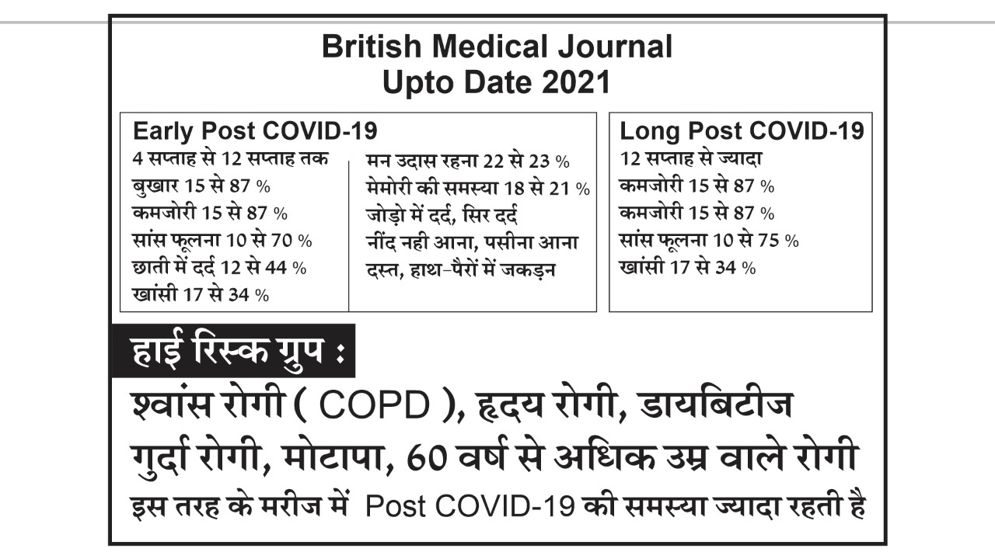

Slide 17
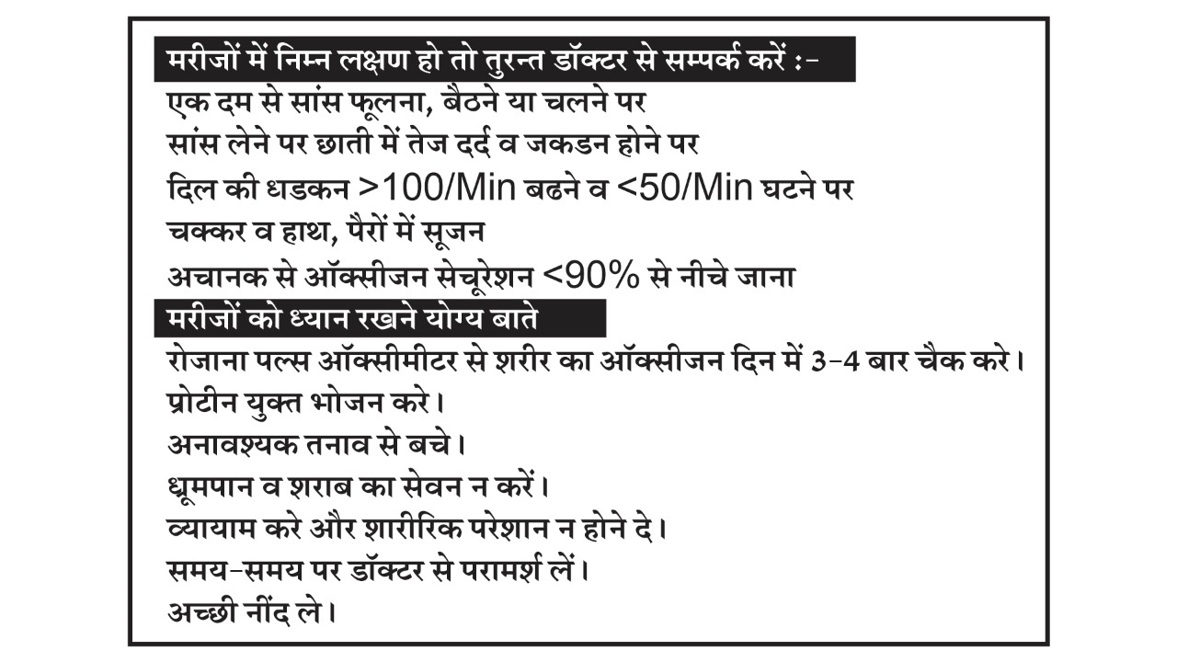

Slide 18

A Bird’ eye view
Covid-19 vaccine

Slide 19
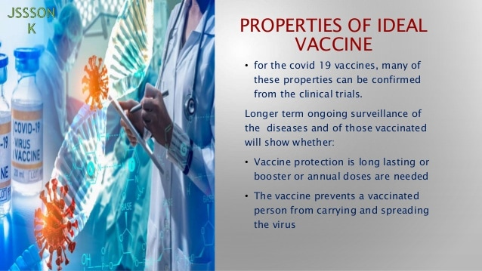

Slide 20
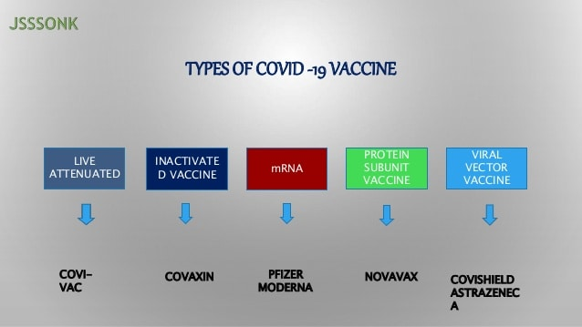

Slide 21
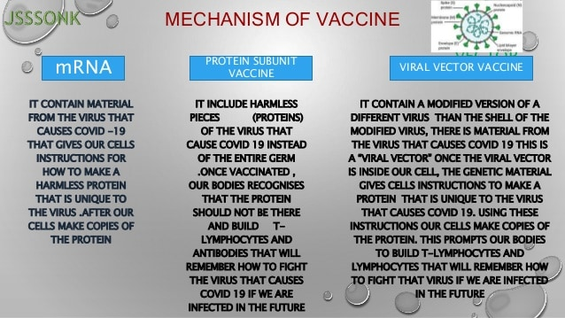

Slide 22
VACCINE DEVELOPMENT
Despite the number of vaccine development projects, WHO has so far validated only six vaccines globally,
The Pfizer-BioNTech vaccine, the Johnson and Johnson vaccine, Sputnik V, Sinopharm-BIBP, Moderna and two AstraZeneca vaccines (produced by SKBio in the Republic of Korea and Serum Institute of India) for emergency use.

Slide 23
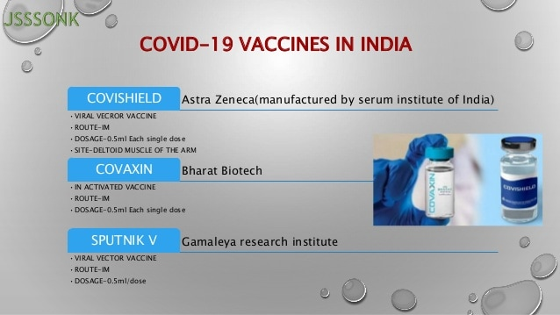

Slide 24
ChAdOx1 nCoV-19/Covisheild
This is one of the most discussed vaccine
AstraZeneca vaccine is co-invented by the University of Oxford and its spin-out company, Vaccitech. It is a weakened version of a common cold virus (adenovirus) that causes infections in chimpanzees and contains the genetic material of the SARS-CoV-2 virus spike protein

Slide 25
Covishield is a monovalent vaccine composed of a single recombinant replication-deficient chimpanzee adenovirus (ChAdOx1) vector encoding the S glycoprotein of SARS-CoV-2
Replication-deficient chimpanzee adenovirus vector encoding the SARS-CoV-2 spikes(s)
Following administration,the S glycoprotein of SARS-CoV-2 is expressed locally stimulating neutralizing antibody and cellular immune responses.
Produced in genetically modified human embryonic kidney (HEK)293 cells.

Slide 26
Side effect of COVISHIELD
Uncommom :- (may affect up to 1 in 100 people)
Swelling and redness where the injection is given.
Fever
Being sick,vomiting,diarrhea
Pain in legs or arms
Flu-like symptoms,itchyskin,rash,hives

Slide 27
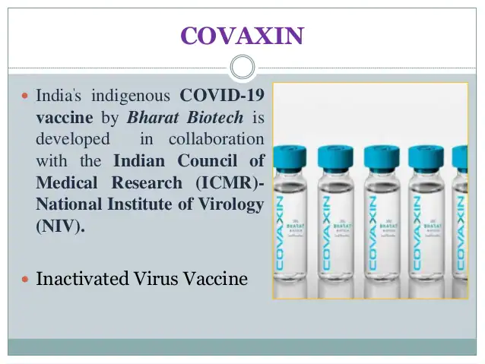

Slide 28
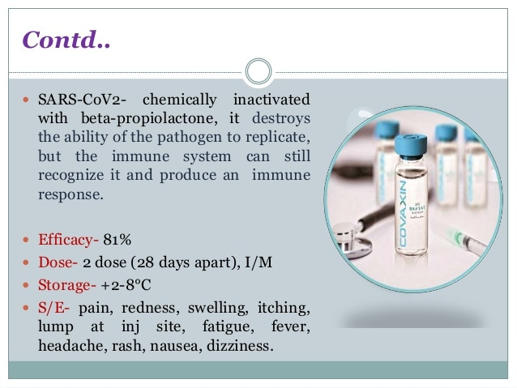

Slide 29
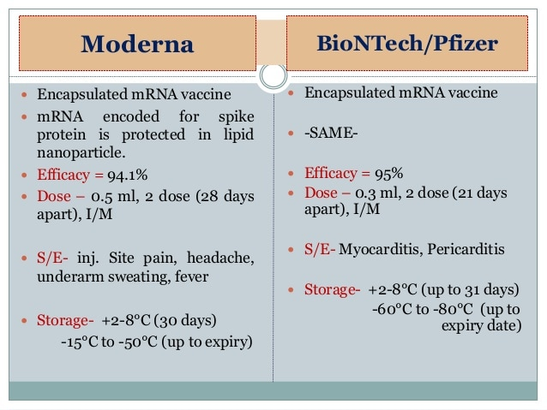

Slide 30
Contraindication of vaccine:-
Any one should not get vaccine if he/she:-
Had a severe allergic reaction to any ingredient of the vaccine.
Had a severe allergic reaction after a previous dose of this vaccine
Currently have an acute infection or fever.

Slide 31
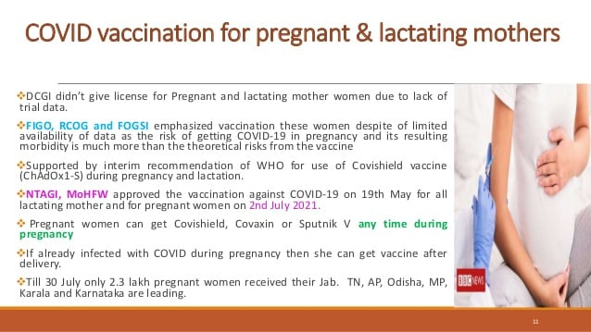

Slide 32
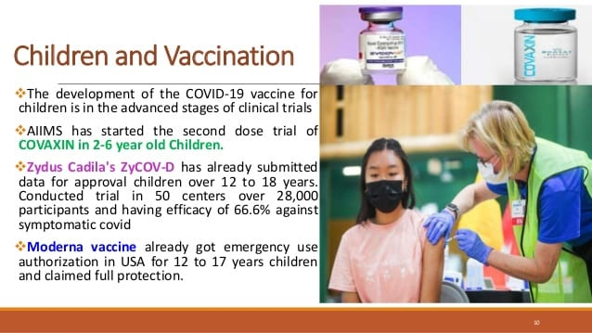

Slide 33
Recent …..
Bharat Biotech's Covaxin is likely to be the only COVID-19 vaccine available,in India for now, for children in the age group of 15-18 years, who will be inoculated from January 3,

Slide 34


